Slide 1
Analysis sales transactions
Professor. Mohammed Al-Sarem
Team member :
Nosiabh Humod Alamri 4051085
Shahad Mansour Aljohani 4052322
Shahad Khaled Almuzaini 4052253
Haneen Mohammed Alzoughibi 4051033

Slide 2
Introduction
One of the problems facing the market is the inability to deal with huge data and thus not achieving the expected income, so the rules of association can help solve this problem by extracting data that frequently appear with each other, to improve marketing plans and analyze the purchasing habits of customers and the difficulties that we will face Finding relationships of association rules between different products.
We used the rules of association, which is a simple and suitable technique for analyzing purchase data and searching for groups of repeating elements. It consists of two steps: creating groups of repeating elements, creating the appropriate rule.
The type of data used is Transaction data obtained from the "kaggle" site and its name is Sales Product Data.

Slide 3
1
Business Understanding

Slide 4
Extract data that is frequently purchased with each other and find association rules between products that will help analyze customers' shopping trends and habits to improve marketing plans.

Slide 5
2
Data Understanding

Slide 6
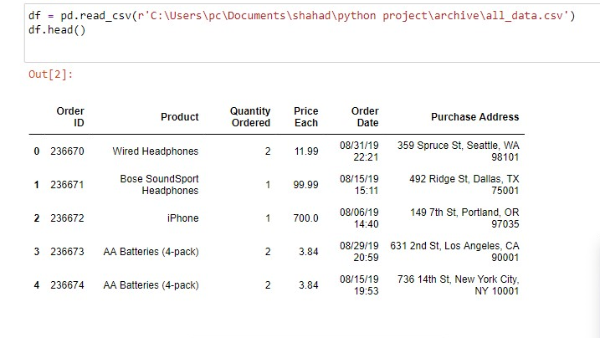
Reviewing the Dataset

Slide 7
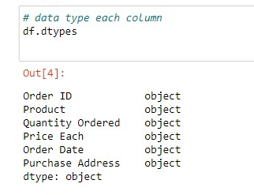
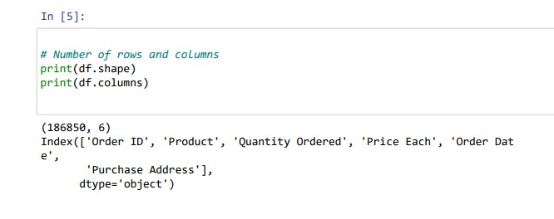
Finding data type and the number of row for each attribute.

Slide 8
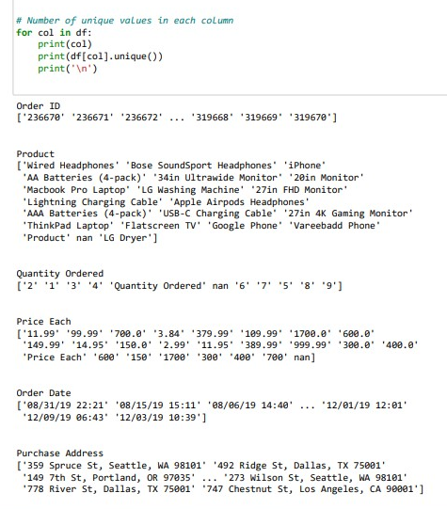
Number of unique values in each column.

Slide 9
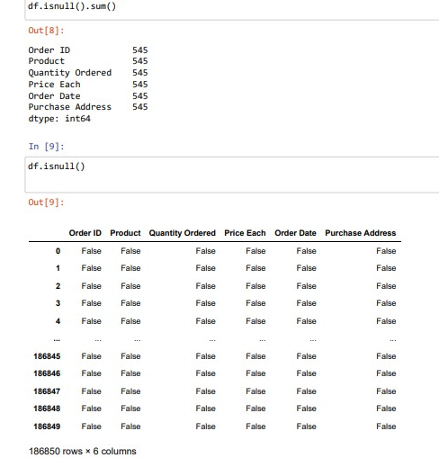
Number of missing values in each column

Slide 10
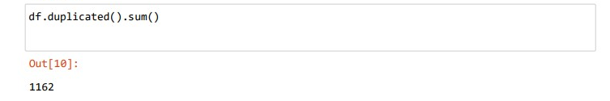
Number of duplicated row

Slide 11
3
Data Preparation

Slide 12
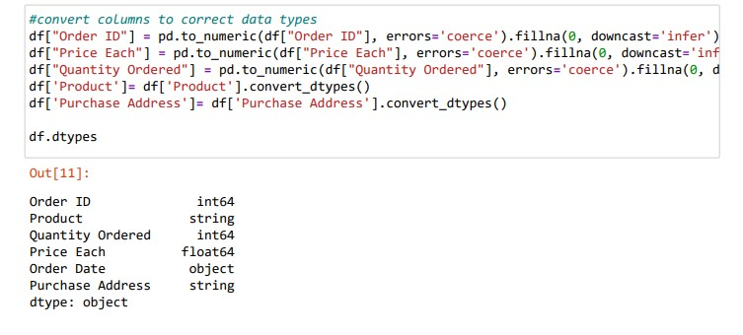
Convert columns to correct data types

Slide 13
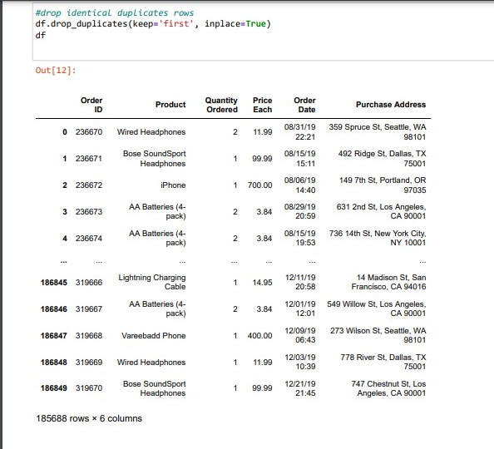
Drop identical duplicates rows

Slide 14
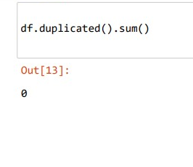
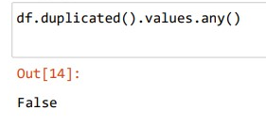
Number of duplicates rows after the drop

Slide 15
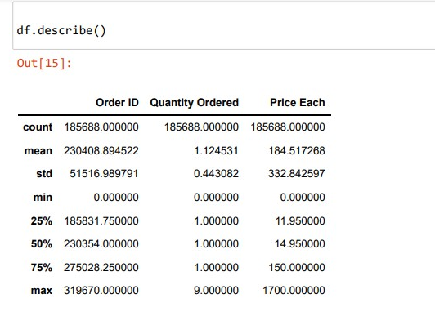
Summarizing statistical Data

Slide 16
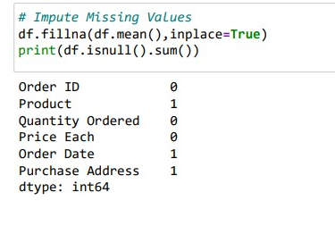
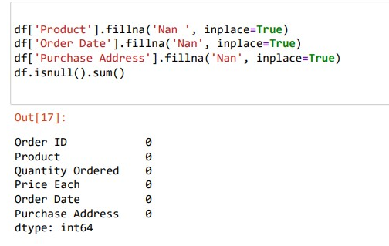
Missing values before and after handling

Slide 17
Data Exploratory Analysis

Slide 18
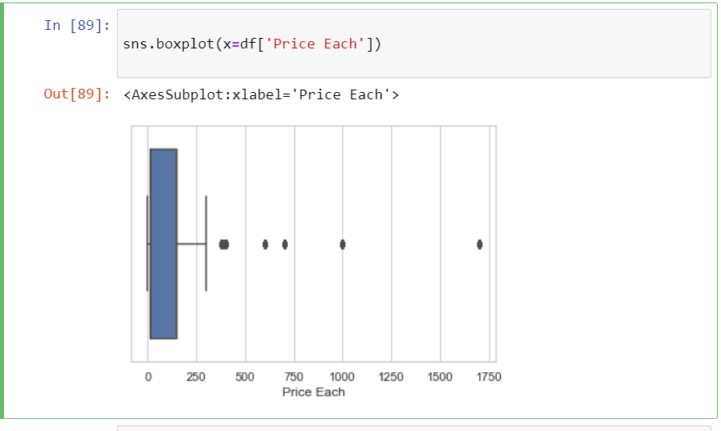
Box plot (Five numbers summary: Minimum, Q1, M, Q3, Maximum) for price attribute

Slide 19
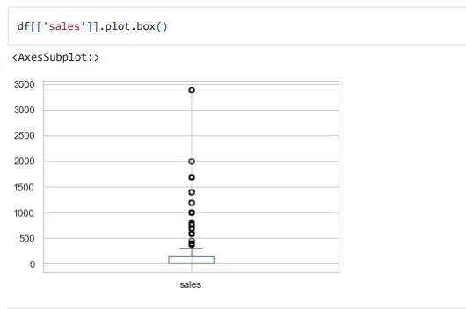
Box plot (Five numbers summary: Minimum, Q1, M, Q3, Maximum) for Sales attribute

Slide 20
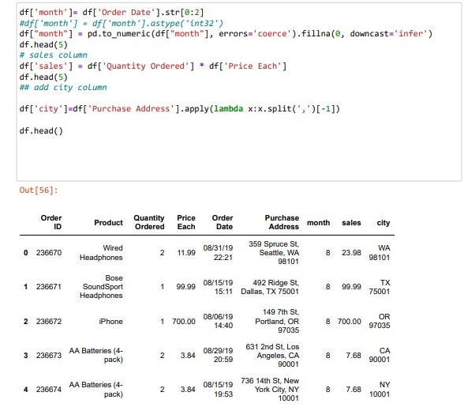
Adding a new attribute name city from the purchase address

Slide 21
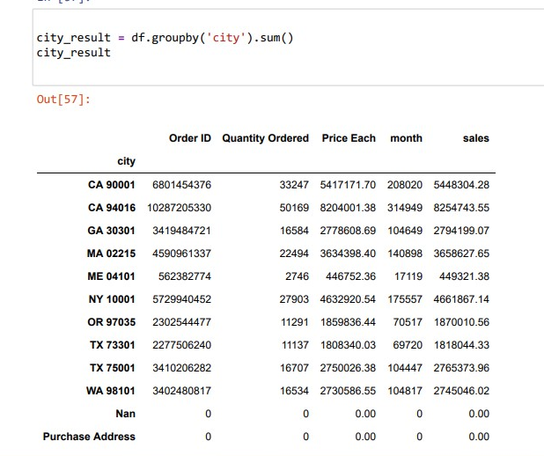
Grouping by the city attribute

Slide 22
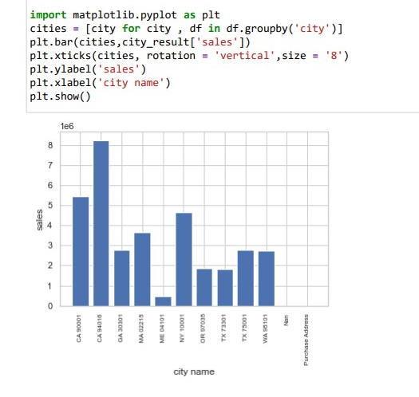
Showing the number of sales based on the city

Slide 23
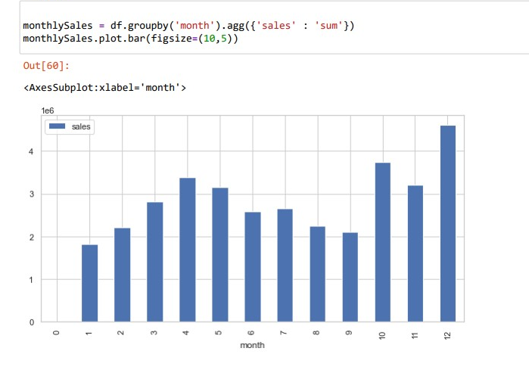
The sum of the monthly sales

Slide 24
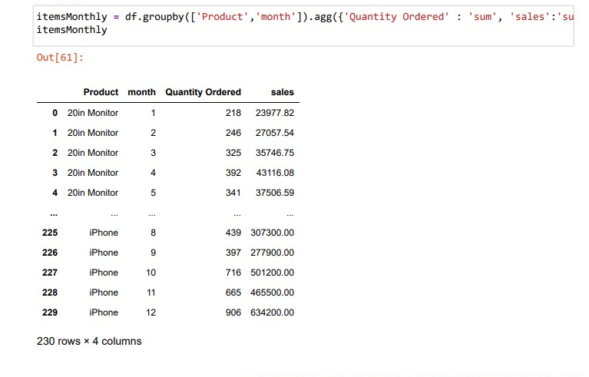
Show the items grouped by the month, product attributes

Slide 25
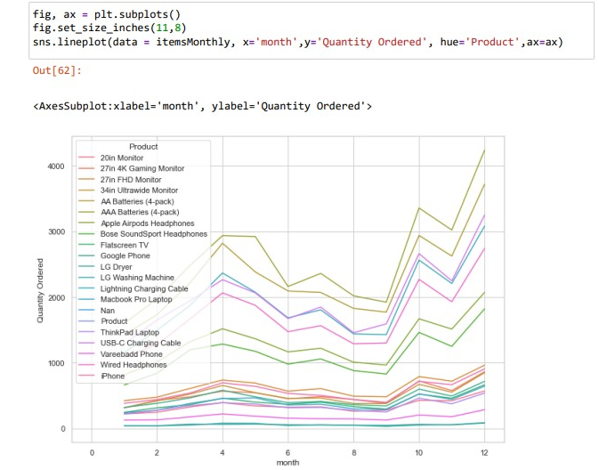
Showing the relationship between the month and the quantity attributes

Slide 26
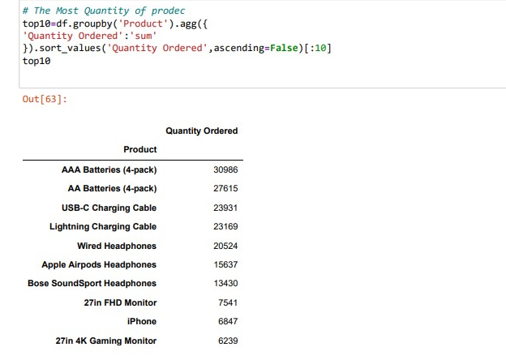
Number of quantity of each product

Slide 27
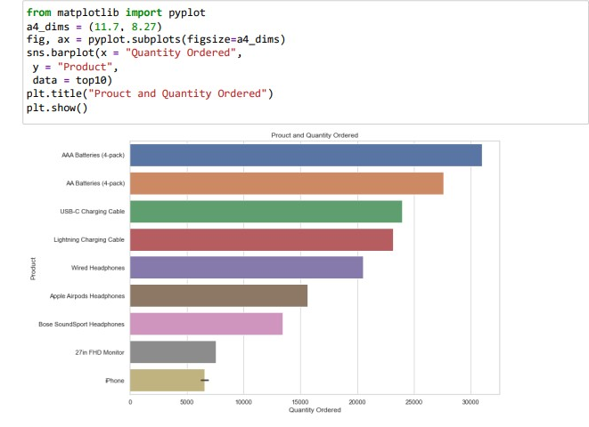
Showing the relationship between the product and the quantity attribute

Slide 28
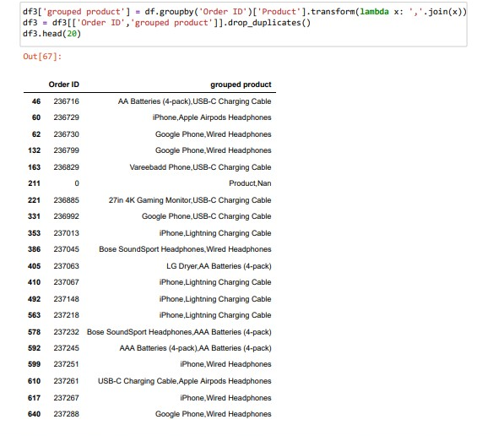
products most often sold together

Slide 29
4
Model Building (Apriori Algorithms,FPgrowth)

Slide 30
Apriori Algorithms

Slide 31
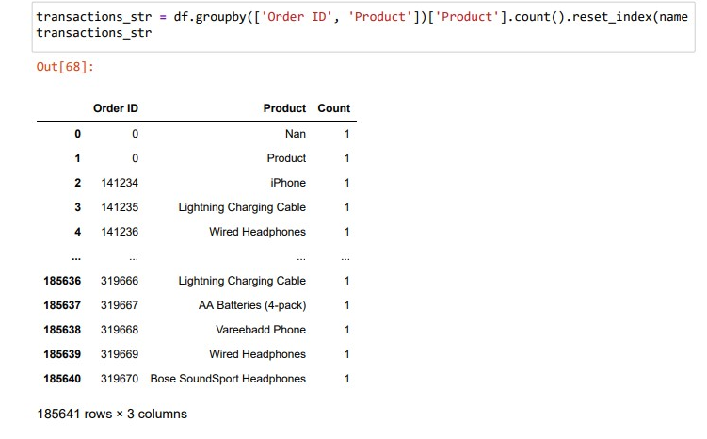
Item set grouped by order id and product attribute

Slide 32
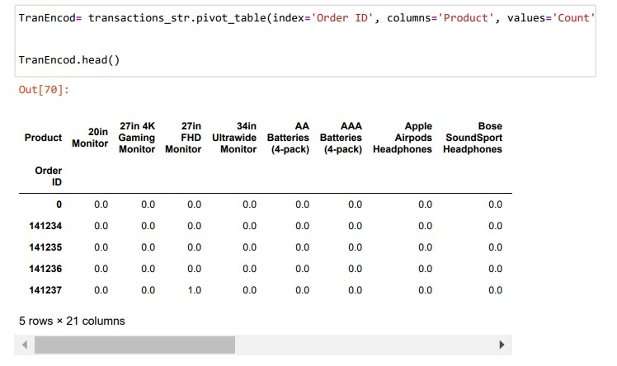
Transaction encoder

Slide 33
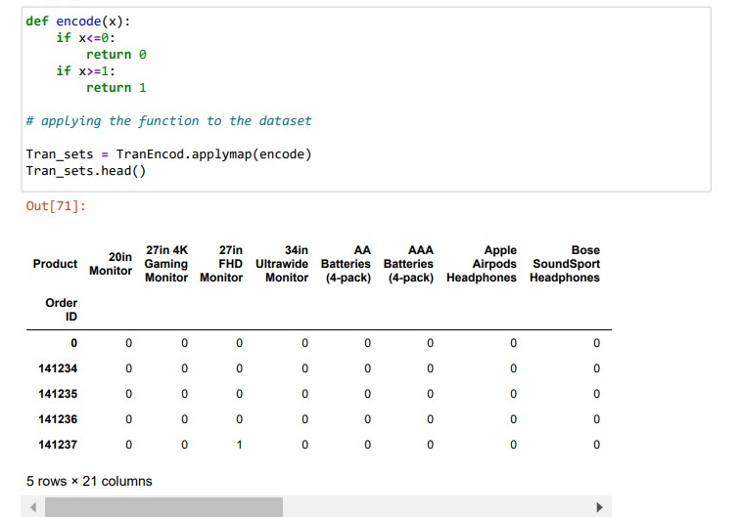
Cont…

Slide 34
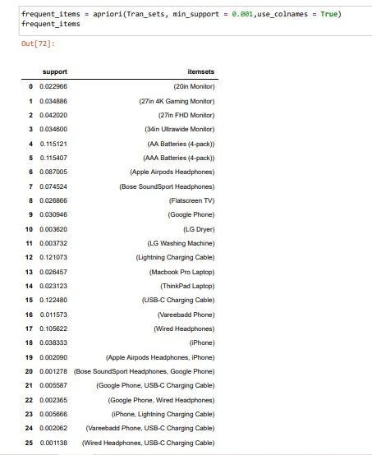
Find the support of the itemset

Slide 35
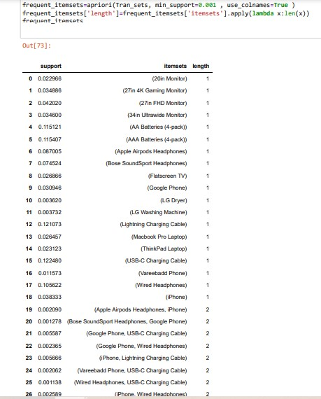
Find the support and length of the itemset

Slide 36
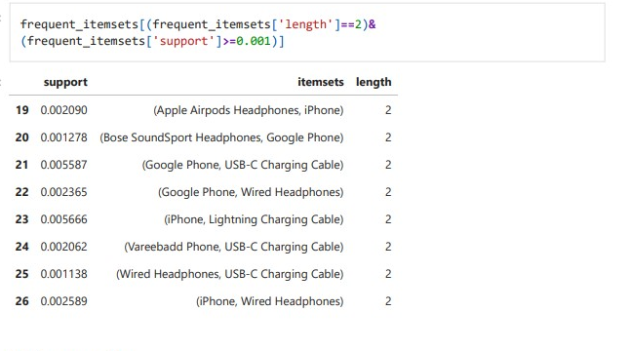
Finding itemset with length =2 and min support grater than 0.001

Slide 37
FP Growth

Slide 38
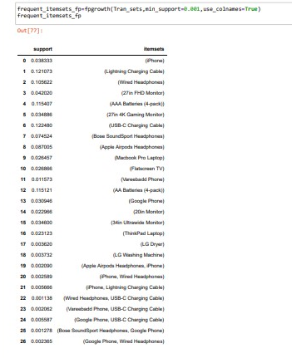
Find the support of the itemset

Slide 39
5
Evaluation

Slide 40
Apriori Algorithms

Slide 41
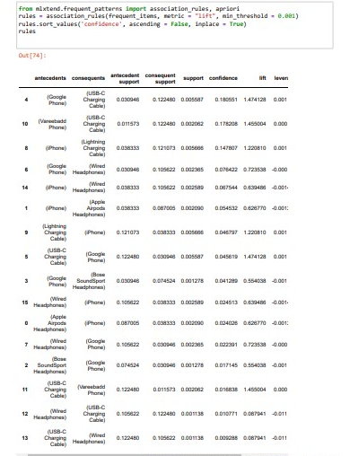
Testing the algorithm accuracy

Slide 42
FP Growth

Slide 43
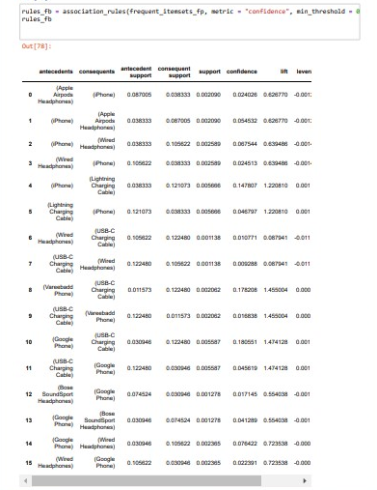
Testing the algorithm accuracy

Slide 44
As we can see from the evaluation result are similar too each other and that proof the accuracy of the algorithm..
Final result

Slide 45
Thank you !

